Slide 1

Welcome
Our presentation on
Machine Learning for a 5G future
Presented By
Md. Samim Hossain ID: IT-17033
Md. Shoriful Islam Sakib ID: IT-17043

Slide 2
What is Machine Learning
Machine learning is the study of computer algorithms that improve automatically through experience.
Machine-learning algorithms use statistics to find patterns in massive amounts of data.

Slide 3
How does machine learning work
Machine learning is a form of artificial intelligence (AI) that teaches computers to think in a similar way to how humans do: learning and improving upon past experiences. It works by exploring data, identifying patterns, and involves minimal human intervention.
Almost any task that can be completed with a data-defined pattern or set of rules can be automated with machine learning

Slide 4
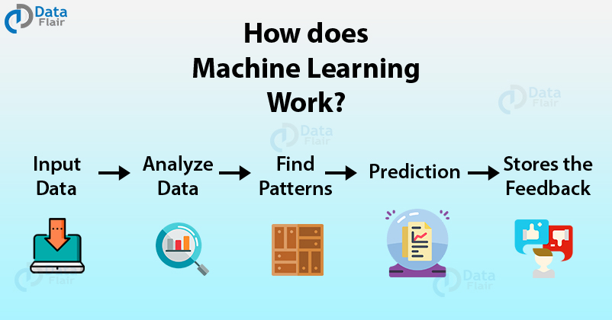
How does machine learning work

Slide 5
Uses of machine learning
We can use machine learning in following sectors
Traffic Alerts
Social Media
Transportation and Commuting
Products Recommendations
Virtual Personal Assistants
Self Driving Cars
Dynamic Pricing
Google Translate
Online Video Streaming
Fraud Detection

Slide 6
What is 5G
5G is next generation wireless network technology that’s expected to change the way people live and work.
It will be faster and able to handle more connected devices than the existing 4G LTE network, improvements that will enable a wave of new kinds of tech products.

Slide 7
Why 5G
Companies are racing to have the fastest or largest 5G networks. And countries are competing to be the first to deploy fully functional, nationwide 5G. That’s because the benefits of the new technology are expected to fuel transformative new technologies, not just for consumers but also for businesses, infrastructure and defense applications.

Slide 8
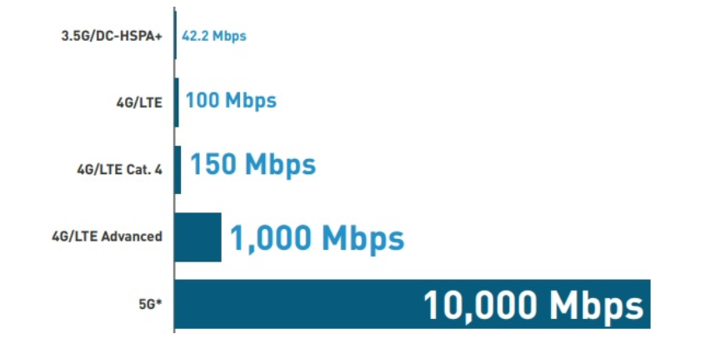
How fast is 5G
5G speed tops out at 10 gigabits per second (Gbps).
5G is 10 to x100 faster than what you can get with 4G.

Slide 9
use case for 5G
There are three major categories of use case for 5G
Massive machine to machine communications
Ultra-reliable low latency communications
Enhanced mobile broadband

Slide 10
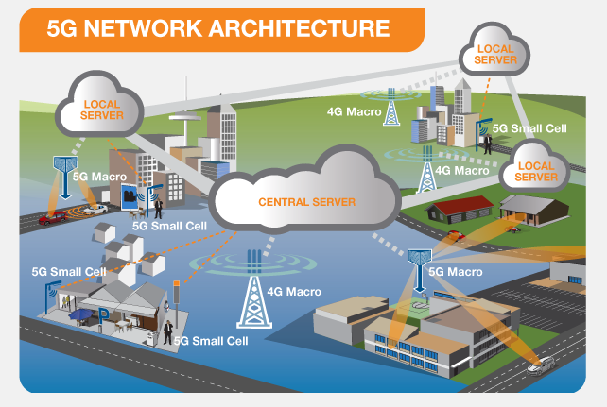
HOW DOES 5G WORK?

Slide 11
Machine Learning in Resource management
Power Control: Cache Control:
Usable algorithm Usable Algorithms
* SVM * Deep Reinforcement Learning
* Q-Learning * Recurrent Neural Networks
* Convolutional Neural networks * Transfer Learning

Slide 12
Machine learning in networking
In networking we use two algorithms. Those are
1. Reinforcement
2. Unsupervised learning
We have three fields there we can use those algorithms of Machine Learning in networking. Those fields –
1. Bs Switching
2.Routing
3. Clustering

Slide 13
Machine Learning in Mobility
Application areas of Machine Learning in relation to connected and autonomous mobility
5G Communication networks
Semi and fully autonomous vehicles
V2X communication protocols
Localization for connected mobility
Massive MIMO antenna systems and beam forming

Slide 14
References
https://en.wikipedia.org/wiki/5G
https://en.wikipedia.org/wiki/Machine_learning
https://algorithmia.com/blog/how-machine-learning-works
https://edition.cnn.com/
https://www.qualcomm.com/

Slide 15
Thank you

